Slide 1
Shoot the Monkey!

Slide 2
Shoot the Monkey!
A monkey is sitting in a tree. For some reason you want to shoot it. But it is an astute (cheeky, even) monkey and will let go of the branch he is swinging from at the same instant you shoot your gun or arrow or blowpipe or whatever weapon you use.
So, where should you aim to guarantee hitting the blighter?
Ignoring air resistance, etc.

Slide 3
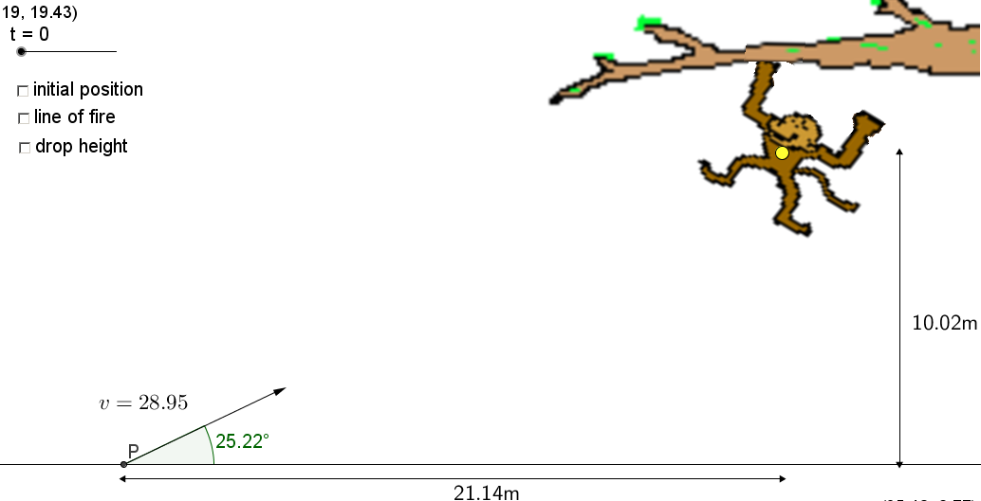
Will the hunter hit his prey?
Notes:
Bullseye!

Slide 4


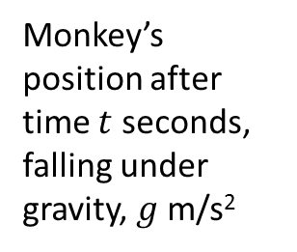


Monkey’s initial position
$$h$$
Monkey’s position after time $t$ seconds, falling under gravity, $g$ m/s²
Path of projectile
$$v$$
$$α$$
$$d$$

Slide 5
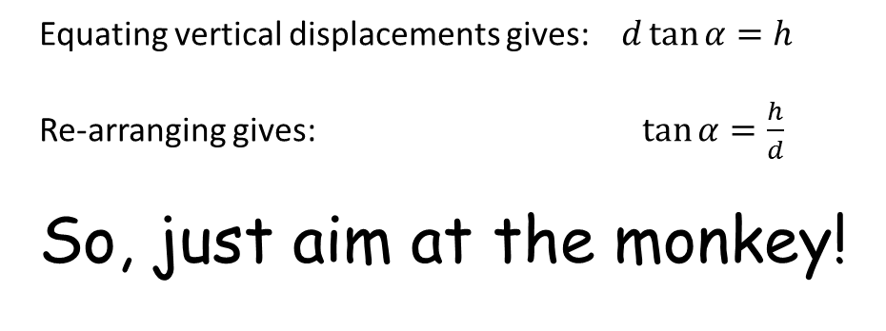
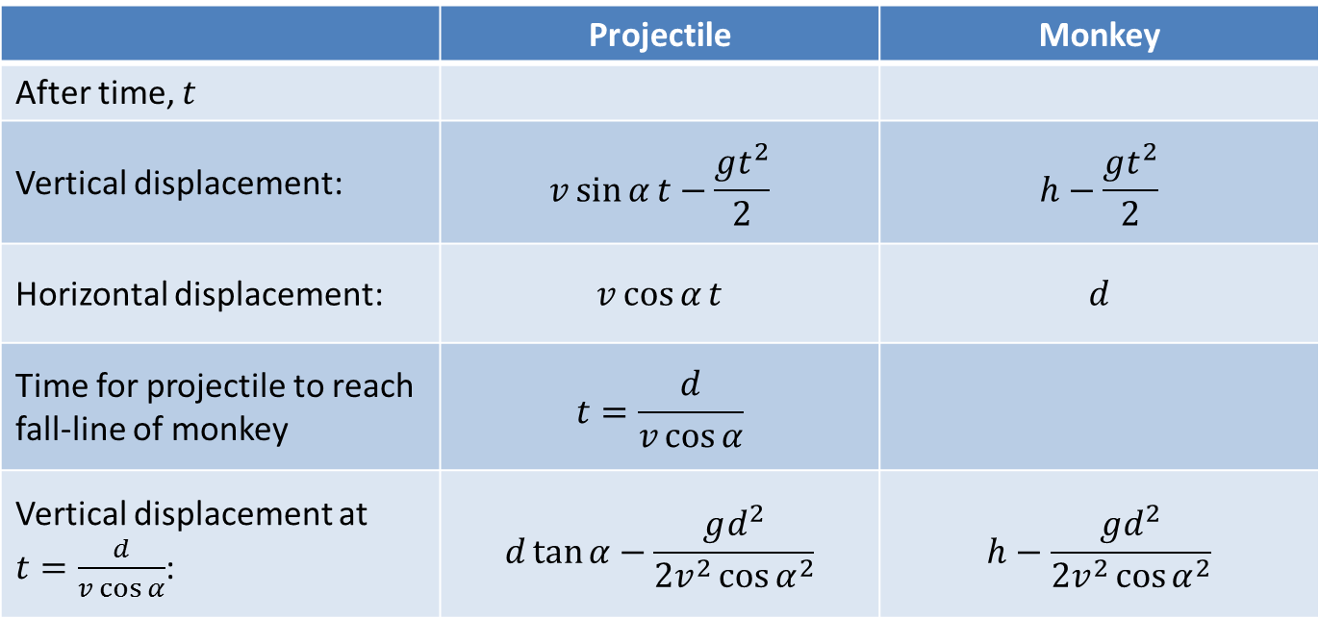
 | Projectile | Monkey
After time, $t$
Vertical displacement: | $$v\sin{α}t−\frac{gt^{2}}{2}$$ | $$h−\frac{gt^{2}}{2}$$
Horizontal displacement: | $$v\cos{α}t$$ | $$d$$
Time for projectile to reach fall-line of monkey | $$t=\frac{d}{v\cos{α}}$$
Vertical displacement at $t=\frac{d}{v\cos{α}}$: | $$d\tan{α}−\frac{gd^{2}}{2v^{2}{\cos{α}}^{2}}$$ | $$h−\frac{gd^{2}}{2v^{2}{\cos{α}}^{2}}$$
Equating vertical displacements gives: $d\tan{α=h}$
Re-arranging gives: $\tan{α}=\frac{h}{d}$
So, just aim at the monkey!

Slide 6
 | Projectile | Monkey
After time, $t$
Vertical displacement: | $$v\sin{α}t−\frac{gt^{2}}{2}$$ | $$h−\frac{gt^{2}}{2}$$
Horizontal displacement: | $$v\cos{α}t$$ | $$d$$
Time for projectile to reach fall-line of monkey | $$t=\frac{d}{v\cos{α}}$$
Vertical displacement at $t=\frac{d}{v\cos{α}}$: | $$d\tan{α}−\frac{gd^{2}}{2v^{2}{\cos{α}}^{2}}$$ | $$h−\frac{gd^{2}}{2v^{2}{\cos{α}}^{2}}$$
Equating vertical displacements gives: $d\tan{α=h}$
Re-arranging gives: $\tan{α}=\frac{h}{d}$
So, just aim at the monkey!

Slide 7

Another way of looking at it is to consider the position vectors of each object and note how they change with time.
Considering the monkey’s position vector first:
Monkey’s initial position
$$r_{monkey}$$

Slide 8

Another way of looking at it is to consider the position vectors of each object and note how they change with time.
Now considering the projectile’s position vector:
Monkey’s initial position
Path of projectile
$$r_{projectile}$$

Slide 9

Another way of looking at it is to consider the position vectors of each object and note how they change with time.
Considering both position vectors:
Monkey’s initial position
$$r_{monkey}$$
$$r_{monkey}=r_{projectile}$$
$$r_{projectile}$$
so collision here

Slide 10
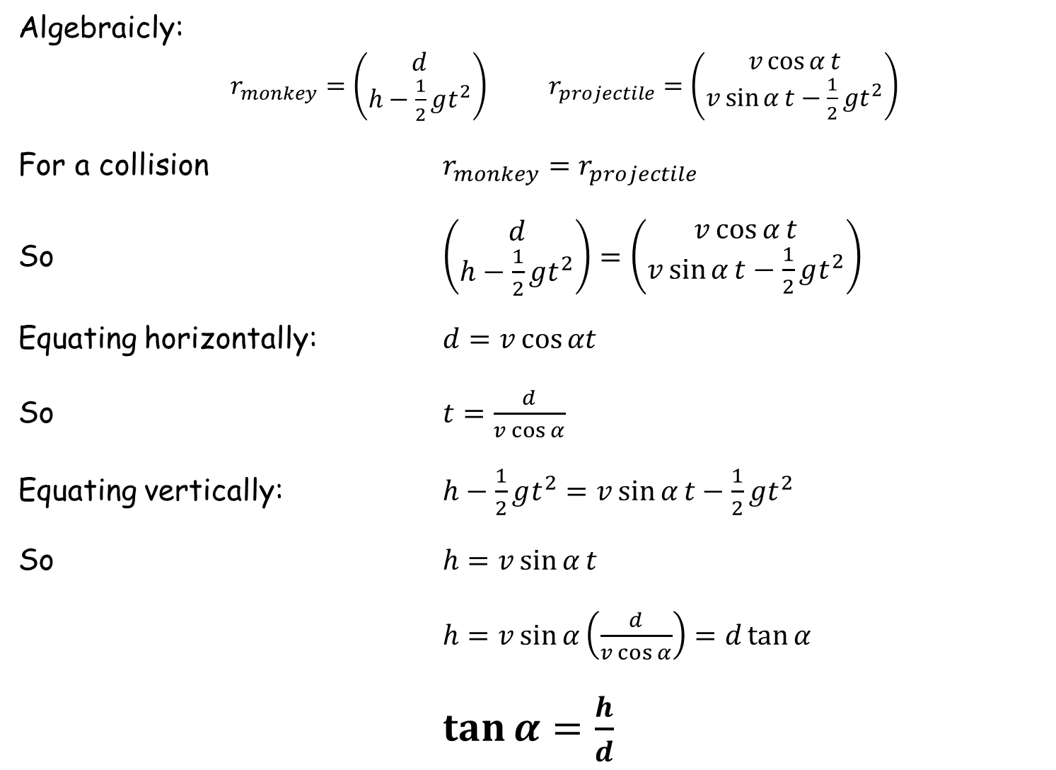
Algebraicly:
$r_{monkey}=\left(\begin{matrix}d \\ h−\frac{1}{2}gt^{2}\end{matrix}\right)$ $r_{projectile}=\left(\begin{matrix}v\cos{α}t \\ v\sin{α}t−\frac{1}{2}gt^{2}\end{matrix}\right)$
For a collision $r_{monkey}=r_{projectile}$
So $\left(\begin{matrix}d \\ h−\frac{1}{2}gt^{2}\end{matrix}\right)=\left(\begin{matrix}v\cos{α}t \\ v\sin{α}t−\frac{1}{2}gt^{2}\end{matrix}\right)$
Equating horizontally: $d=v\cos{αt}$
So $t=\frac{d}{v\cos{α}}$
Equating vertically: $h−\frac{1}{2}gt^{2}=v\sin{α}t−\frac{1}{2}gt^{2}$
So $h=v\sin{α}t$
$h=v\sin{α}\left(\frac{d}{v\cos{α}}\right)=d\tan{α}$
$\tan{α}=\frac{h}{d}$

Slide 11
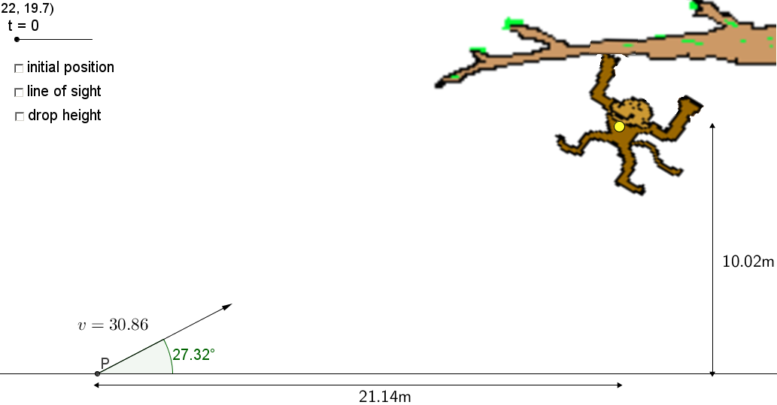
Will the hunter hit his prey?
Notes:
misses

Slide 12
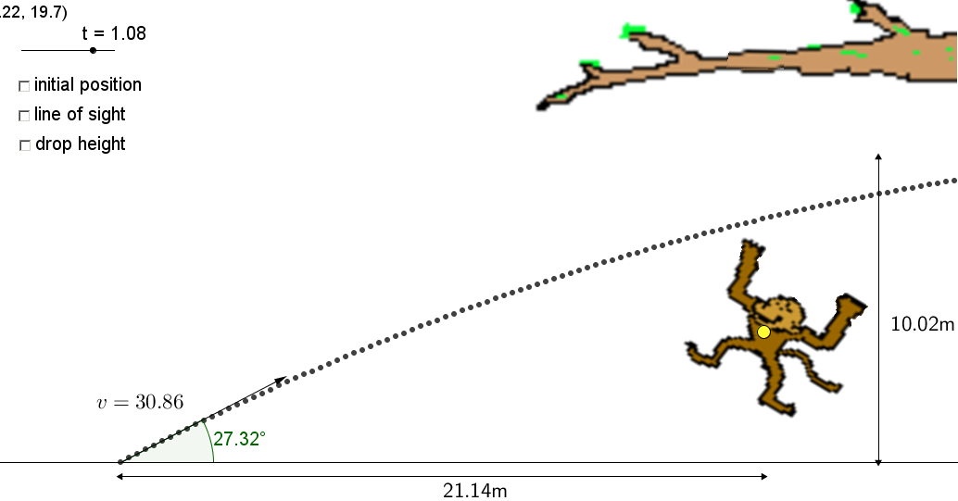
Will the hunter hit his prey?
HA, YOU MISSED ME!

Slide 13
Will the hunter hit his prey?
Notes:
Bullseye!

Slide 14
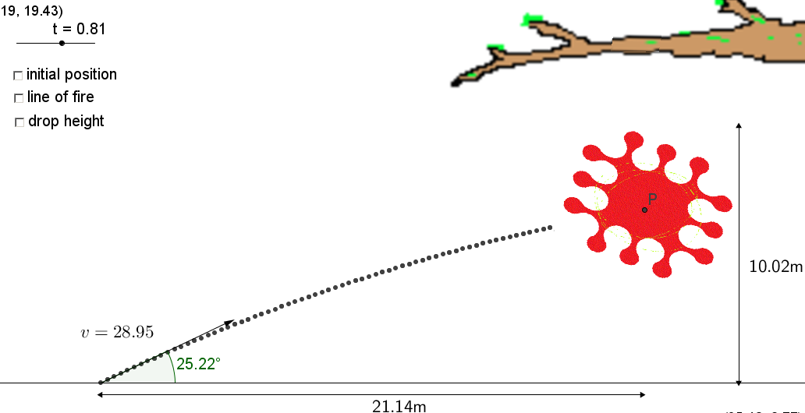
Will the hunter hit his prey?
AAAARGHHHH!
Notes:
Bullseye!

Slide 15

Will the hunter hit his prey?
First scenario – with line of fire

Slide 16
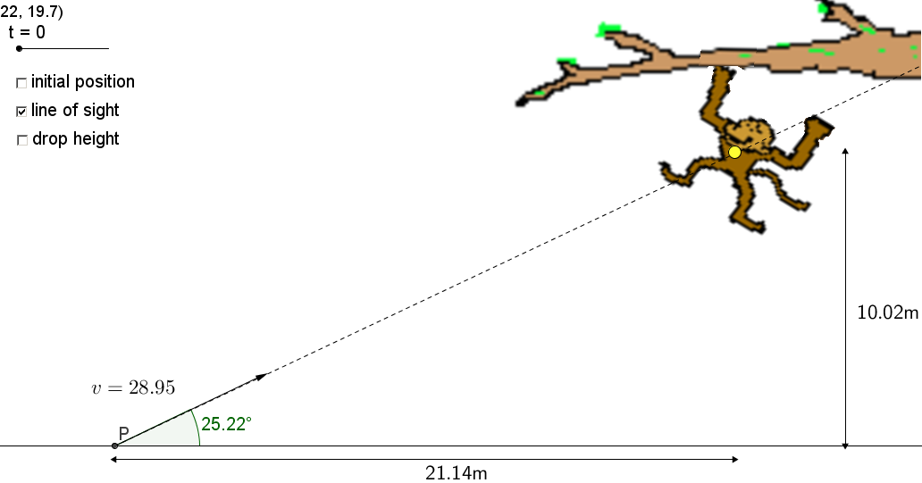
Will the hunter hit his prey?
Second scenario – with line of fire

Slide 17
This scenario hits the target
(line of fire is on the target)
This scenario does not hit the target
(line of fire is not on the target)

Slide 18
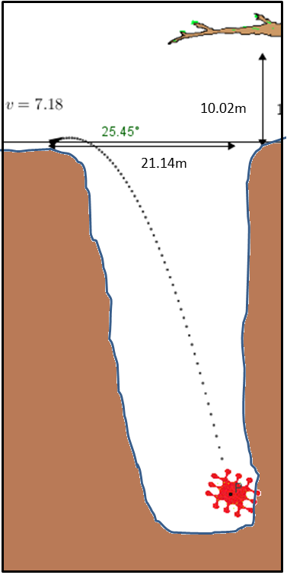
No matter what initial velocity the projectile has the only criteria for hitting the target is that the projectile is aimed directly at it.
The initial velocity only determines when the target is hit. A small velocity will obviously take longer and so hunter and target should be on opposite sides of a very deep canyon!

Slide 19
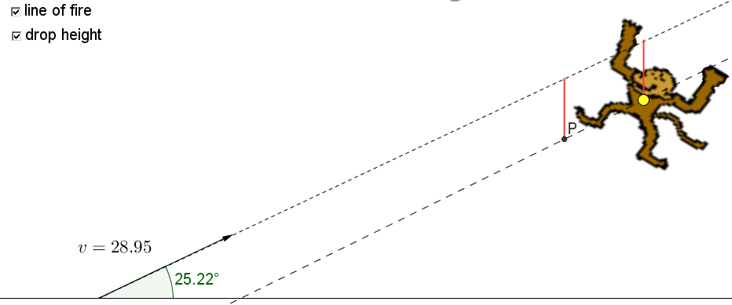
Another way of thinking about it is to note that each object (projectile and monkey) have identical vertical acceleration – gravity. So, subtract that motion from each object and analyse. It is now as though gravity is zero so the answer of aiming directly at the target becomes obvious.
Each object has “fallen” the same distance.

Slide 21
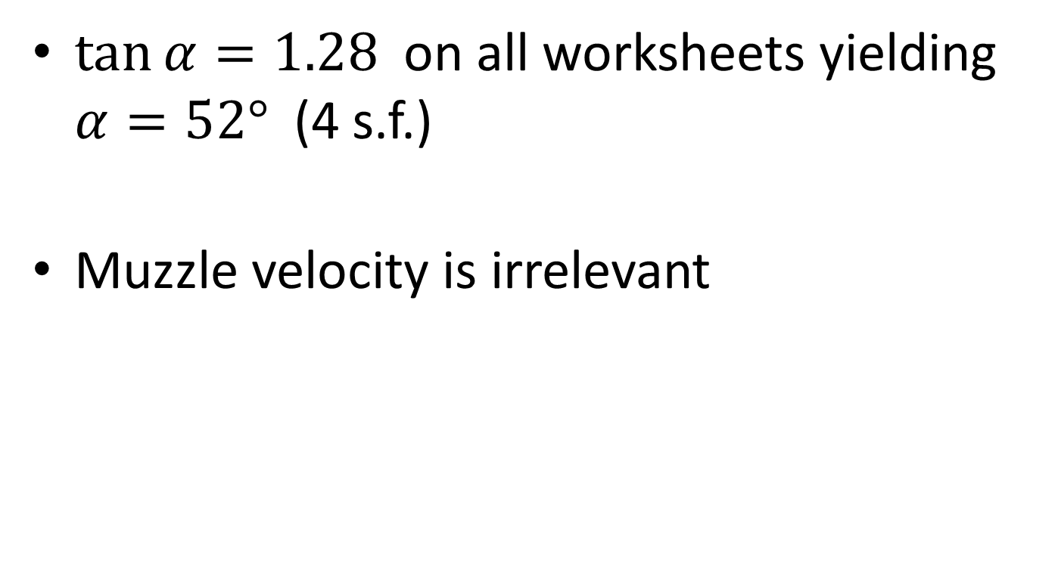
Note to Teacher
$\tan{α=1.28}$ on all worksheets yielding $α=52°$ (4 s.f.)
Muzzle velocity is irrelevant

Slide 22
RESOURCES

Slide 23
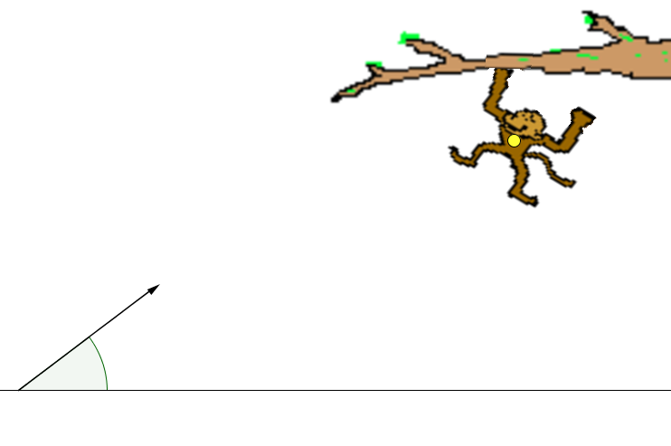

Shoot the Monkey!
The instant you shoot, the monkey lets go and falls to the ground.
What angle ensures you hit him?
9.81 ms⁻²
21.5 ms⁻¹
33.92 m
$$α=?$$
26.5 m
(Not to scale)
SIC_26

Slide 24
Shoot the Monkey!
The instant you shoot, the monkey lets go and falls to the ground.
What angle ensures you hit him?
9.81 ms⁻²
23.5 ms⁻¹
35.2 m
$$α=?$$
27.5 m
(Not to scale)
SIC_26

Slide 25
Shoot the Monkey!
The instant you shoot, the monkey lets go and falls to the ground.
What angle ensures you hit him?
9.81 ms⁻²
25 ms⁻¹
36.48 m
$$α=?$$
28.5 m
(Not to scale)
SIC_26

Slide 26
Shoot the Monkey!
The instant you shoot, the monkey lets go and falls to the ground.
What angle ensures you hit him?
9.81 ms⁻²
26.2 ms⁻¹
37.76 m
$$α=?$$
29.5 m
(Not to scale)
SIC_26

Slide 27
Shoot the Monkey!
The instant you shoot, the monkey lets go and falls to the ground.
What angle ensures you hit him?
9.81 ms⁻²
26.2 ms⁻¹
41.6 m
$$α=?$$
32.5 m
(Not to scale)
SIC_26

Slide 28
Shoot the Monkey!
The instant you shoot, the monkey lets go and falls to the ground.
What angle ensures you hit him?
9.81 ms⁻²
30 ms⁻¹
48.0 m
$$α=?$$
37.5 m
(Not to scale)
SIC_26

Slide 29
Shoot the Monkey!
The instant you shoot, the monkey lets go and falls to the ground.
What angle ensures you hit him?
9.81 ms⁻²
31.2 ms⁻¹
49.2 m
$$α=?$$
38.5 m
(Not to scale)
SIC_26

Slide 30
Shoot the Monkey!
The instant you shoot, the monkey lets go and falls to the ground.
What angle ensures you hit him?
9.81 ms⁻²
32.2 ms⁻¹
50.56 m
$$α=?$$
39.5 m
(Not to scale)
SIC_26

Slide 31
Shoot the Monkey!
The instant you shoot, the monkey lets go and falls to the ground.
What angle ensures you hit him?
9.81 ms⁻²
33.4 ms⁻¹
51.84 m
$$α=?$$
40.5 m
(Not to scale)
SIC_26

Slide 32
Shoot the Monkey!
The instant you shoot, the monkey lets go and falls to the ground.
What angle ensures you hit him?
9.81 ms⁻²
35.4 ms⁻¹
53.12 m
$$α=?$$
41.5 m
(Not to scale)
SIC_26

Slide 33
Shoot the Monkey!
The instant you shoot, the monkey lets go and falls to the ground.
What angle ensures you hit him?
9.81 ms⁻²
36 ms⁻¹
54.4 m
$$α=?$$
42.5 m
(Not to scale)
SIC_26

Slide 34
Shoot the Monkey!
The instant you shoot, the monkey lets go and falls to the ground.
What angle ensures you hit him?
9.81 ms⁻²
39.7 ms⁻¹
55.68 m
$$α=?$$
43.5 m
(Not to scale)
SIC_26

Slide 36
Shoot the Monkey!
Will the hunter hit his prey?
Notes:
Bullseye!

